Slide 1

Python Control Flow

Slide 2

Manishkumar R Solanki
Sr. Lecturer, Information Technology,
manish_ratilal2002@yahoo.com
SBMP

Slide 3
Students will be able to:
Apply different types of if statements in Python programs
Apply switcher statements in Python programs
Apply while and for loops in Python programs
Use range() function in Python programs
Use pass statement

Slide 4
Conditional Statements

Slide 5
Simple if statement
Used when we want to check only one condition. [We don’t want to handle otherwise(else) part]
Syntax:
if Expression :
Indented Block
Example:
age=int(input("Enter the age:"))
if age >= 60:
print("You are a senior citizen")
print("End of script")
Enter the age:56
End of script
Enter the age:89
You are a senior citizen
End of script

Slide 6
If…else statement
Used when we want to check exactly 2 different conditions. [We want to handle otherwise(else) part as well]
Syntax:
if Expression :
Indented Block 1
else :
Indented Block 2
Example:
age=int(input("Enter the age:"))
if age >= 60:
print("You are a senior citizen")
else:
print("You are not a senior citizen")
print("End of script")
Enter the age:56
You are not a senior citizen
End of script
Enter the age:60
You are a senior citizen
End of script

Slide 7
If…elif…else statement
Used when we want to check more than 2 conditions.
Syntax:
if Expression_1 :
Indented Block 1
elif Expression_2 :
Indented Block 2
elif Expression_3 :
Indented Block 3
...
...
else :
Indented Block N

Slide 8
If…elif…else statement
Example:
age=int(input("Enter the age:"))
if age<13:
print("You are a child.")
elif age>=13 and age<18 :
print("You are a teen ager.")
elif age>=18 and age<60 :
print("You are an adult.")
else:
print("You are a senior citizen.")
print("End of script")
Enter the age:10
You are a child.
End of script
Enter the age:15
You are a teen ager.
End of script
Enter the age:50
You are an adult.
End of script
Enter the age:60
You are a senior citizen.
End of script

Slide 9
switcher statement
The switch…case is not available in Python as C/C++/JAVA
We have to define a function to provide switcher as shown below:
Example:
def week(i):
switcher={
0:'Sunday',
1:'Monday',
2:'Tuesday',
3:'Wednesday',
4:'Thursday',
5:'Friday',
6:'Saturday'
}
return switcher.get(i,"Invalid day of week")
print(week(7))
Invalid day of week
If we provide value of i from 0 to 6, it will display valid Week Day.

Slide 10
Python Loops

Slide 11
While loop
Syntax:
Counter initialization
while (checking condition): executable statements updation of a counter
Example:
sum = 0
i=1
print("Enter n")
n=int(input())
while i <= n:
sum=sum+i
i += 1
print("The sum of first",n,"terms=",sum)
Enter n
4
The sum of first 4 terms= 10

Slide 12
break and continue statements are same as C/C++/JAVA

Slide 13
While…else loop
i = 1
while i <7 :
print(i)
i += 1
else:
print("i is no longer less than 7")
1
2
3
4
5
6
i is no longer less than 7

Slide 14
for loop
The for loop is used for iterating over a sequence (a list, a tuple, a dictionary, a set, or a string).
for loop with a list
languages = ["C", "C++", "Java","Python"]
for l in languages:
print(l)
C
C++
Java
Python

Slide 15
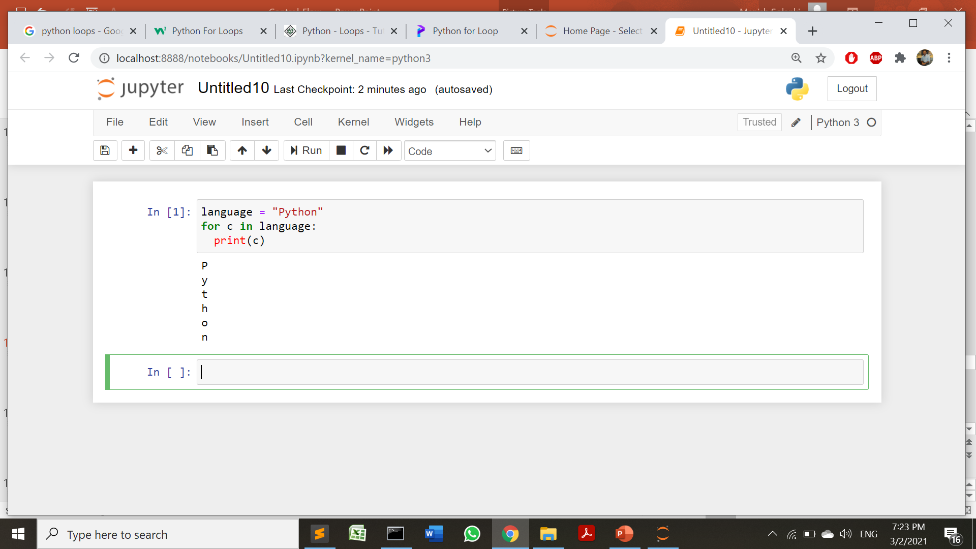
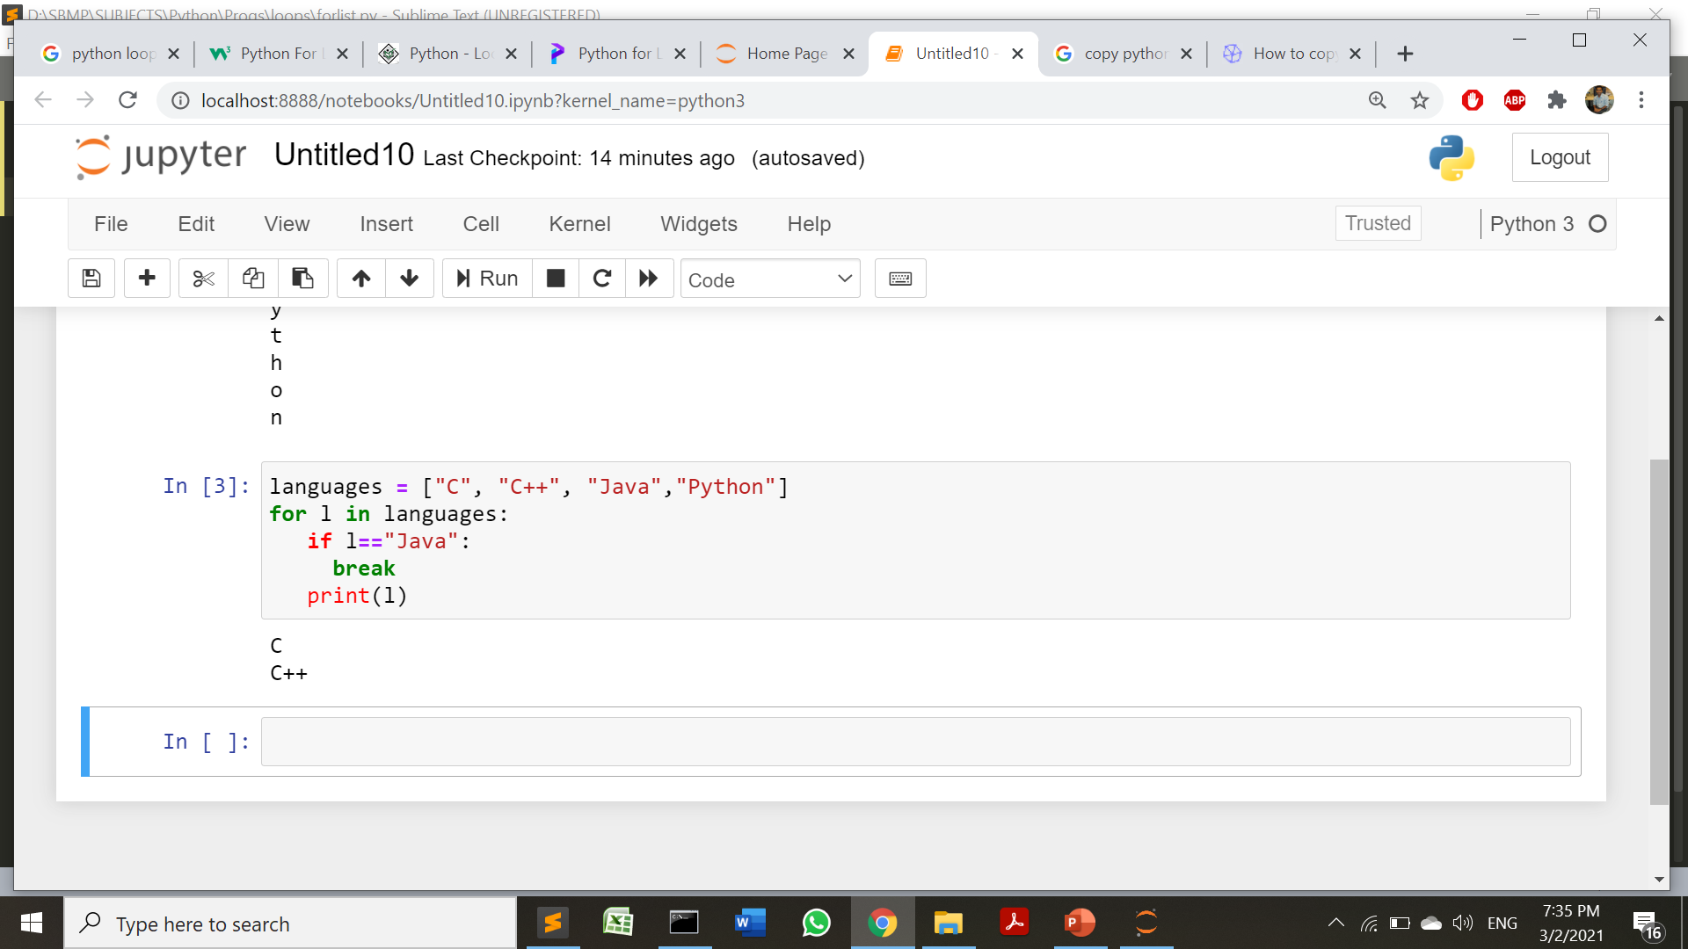
for loop
for loop with a String

Slide 16
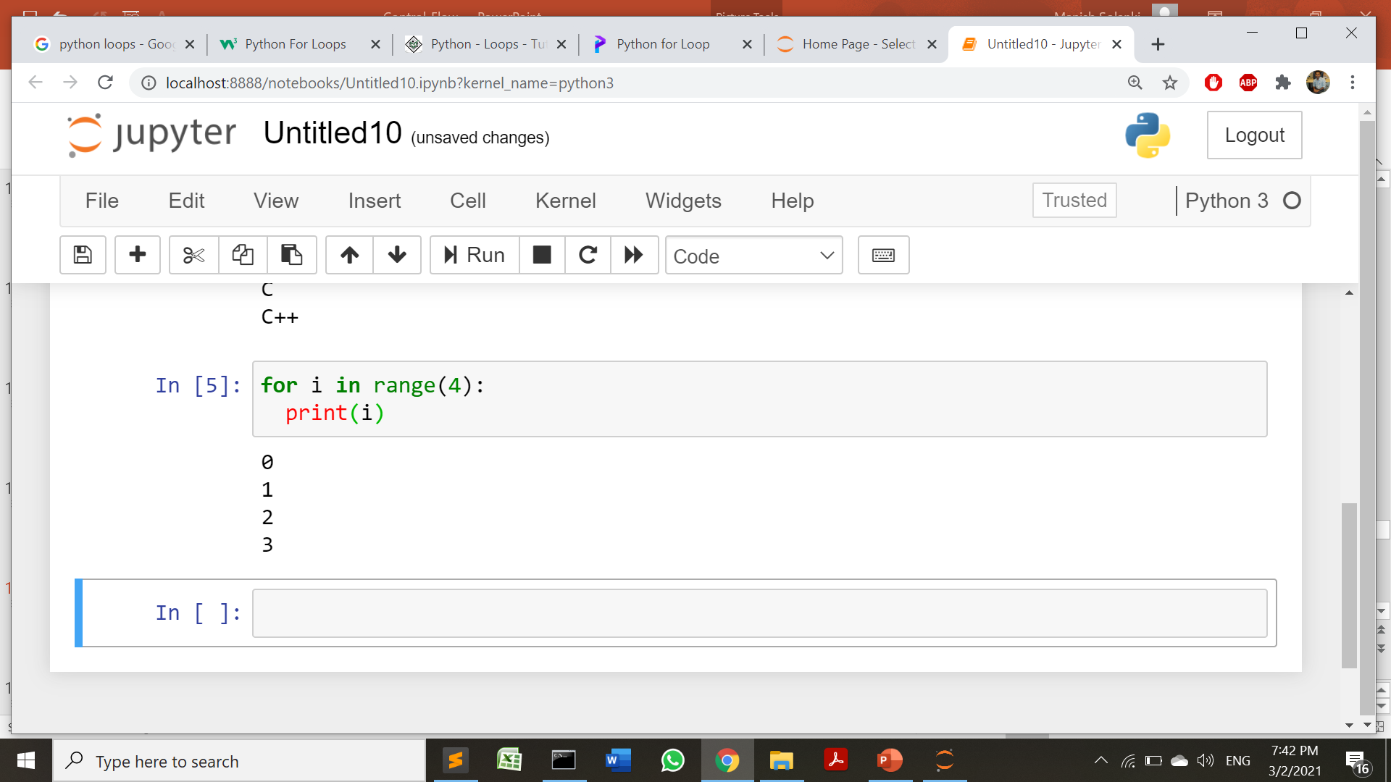
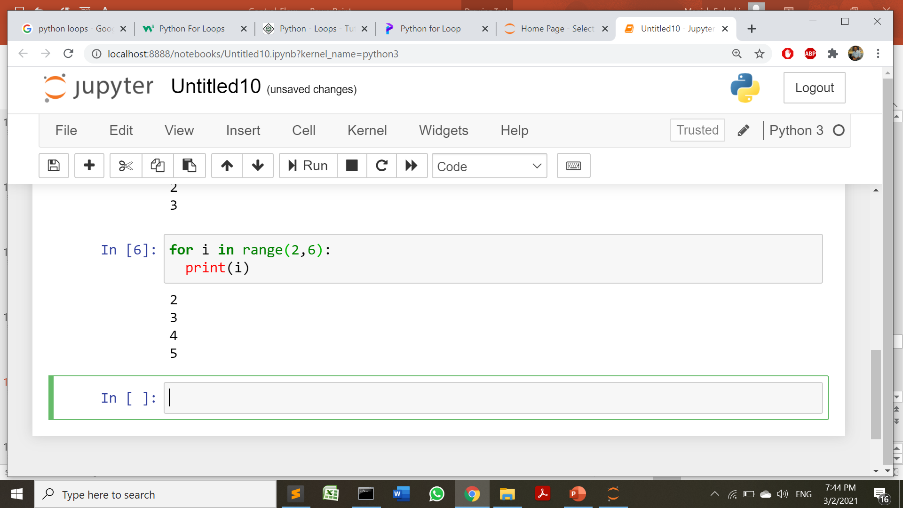
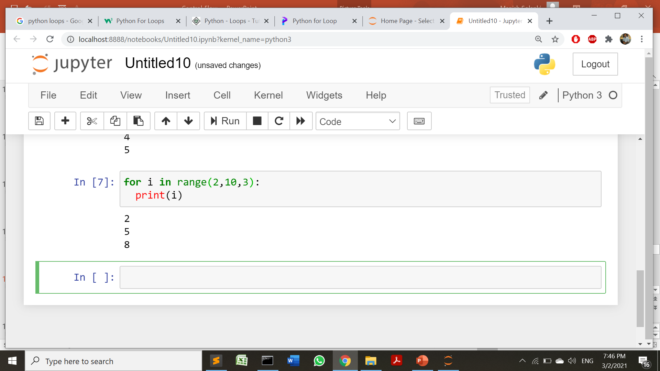
range() function
The range() function returns a sequence of numbers, starting from 0 by default, and increments by 1 (by default), and ends at a specified number(n -1).
without start and increment part
without increment part(start,end)
with All 3 parts

Slide 17
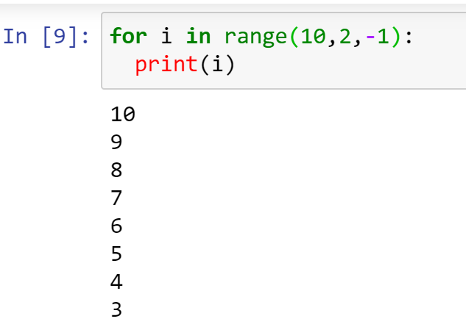
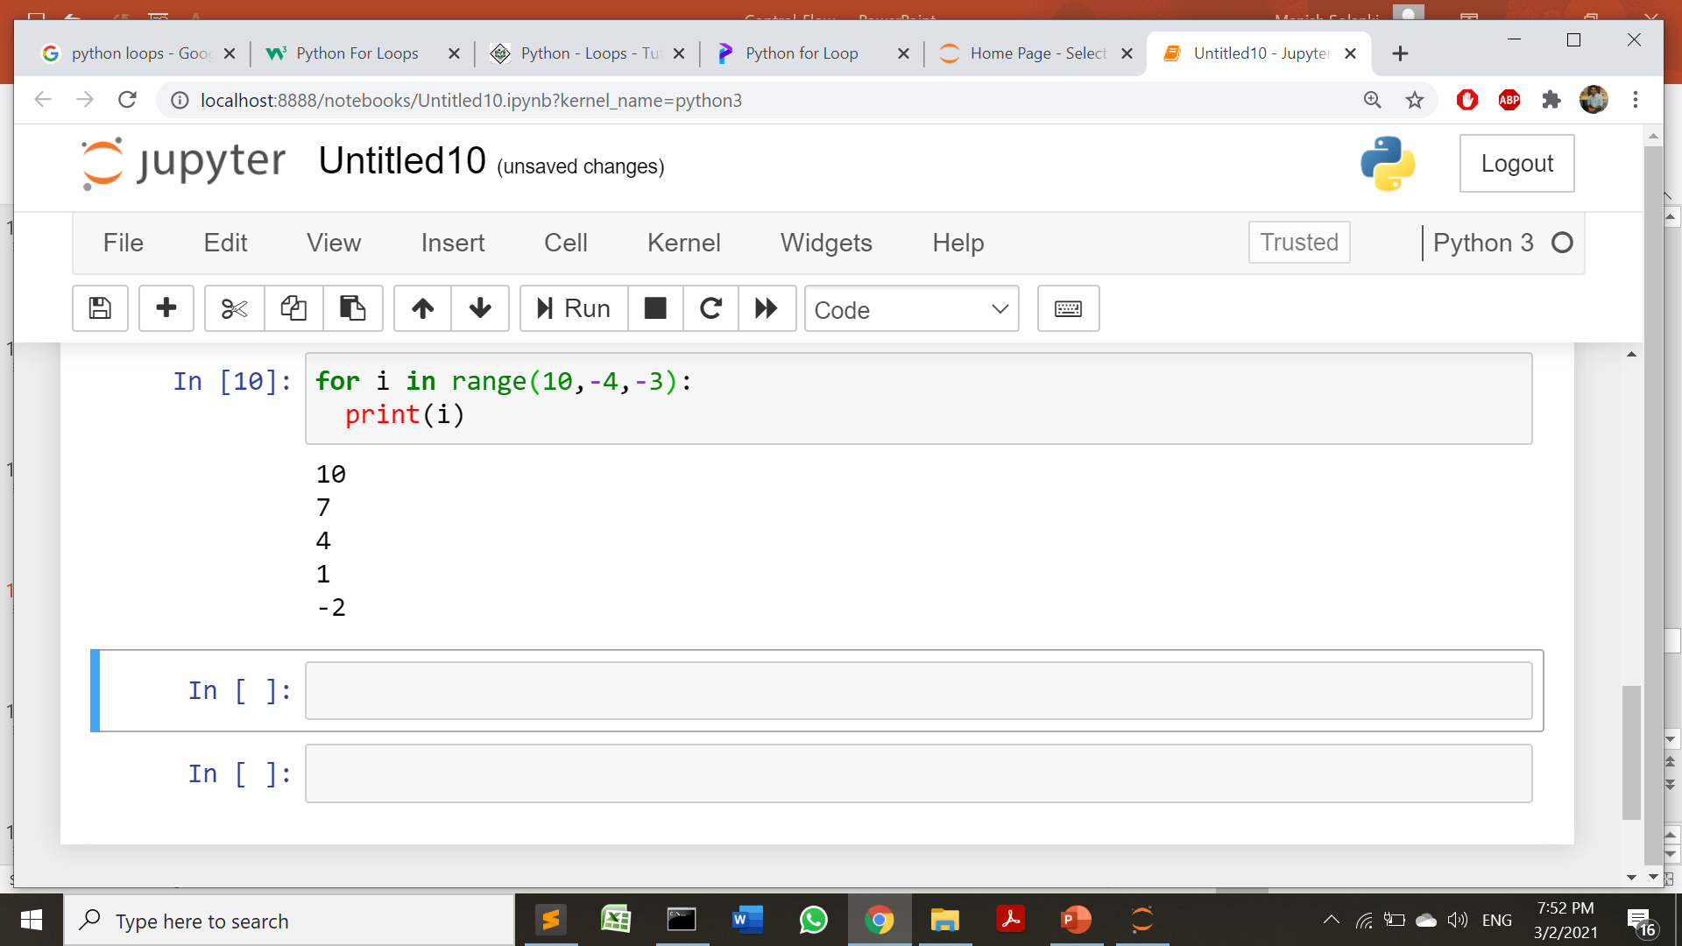
range() function
Reverse order printing

Slide 18
Nested loops can be used as we use in C/C++/Java

Slide 19
pass statement
The pass statement is a null statement.
Nothing happens when the pass is executed. It results in no operation (NOP).
In Python a loop or function cannot have an empty body. Suppose we have a loop or a function that is not implemented yet, but we want to implement it in the future.
So, we use the pass statement to construct a body that does nothing.
list1 = ['p', 'a', 's', 's']
for val in list1:
pass
def fun(args):
pass
class MyClass:
pass

Slide 20
Exercises

Slide 21
Exercises
Write a Python program to check a triangle is equilateral, isosceles or scalene.
Note :
An equilateral triangle is a triangle in which all three sides are equal.
A scalene triangle is a triangle that has three unequal sides.
An isosceles triangle is a triangle with (at least) two equal sides.
Expected Output:
Input lengths of the triangle sides:
x: 6
y: 8
z: 12
Scalene triangle

Slide 22
Exercises
Q: Write a Python program which iterates the integers from 1 to 50. For multiples of three print "Fizz" instead of the number and for the multiples of five print "Buzz". For numbers which are multiples of both three and five print "FizzBuzz".
Sample Output : fizzbuzz 1 2 fizz 4 buzz

Slide 23
Exercises
Q: Write a Python program which calculates the frequency of students for the given range of marks:
i.e. For the marks entered for 20 students out of 100
0-39 = 2
40-59 = 4
60-69 = 10
70-89 = 3
90-100=1

Slide 24
Exercises
Q: Write a Python program to create the multiplication table (from 1 to 10) of a number.
Expected Output:
Input a number: 6
6 x 1 = 6
6 x 2 = 12
6 x 3 = 18
6 x 4 = 24
6 x 5 = 30
6 x 6 = 36
6 x 7 = 42
6 x 8 = 48
6 x 9 = 54
6 x 10 = 60

Slide 25
Exercises
Q1: Write a Python script to calculate the BMI of a person.
BMI Categories: Underweight = <18.5 Normal weight = 18.5–24.9 Overweight = 25–29.9 Obesity = BMI of 30 or greater
Q2: Write a Python script to calculate the summation of first 20 natural numbers.
Q3: Calculate electricity bill of your house.
Q4: Calculate the net salary of an employee from the given details of basic salary, allowances and income tax slabs.
Q5: Factorial of a given number.
Q6: Triangle Pattern Programs of C/C++
Q7: Mathematical Series Problems

Slide 26
References
https://realpython.com/python-data-types/
https://www.guru99.com/python-operators-complete-tutorial.html
https://data-flair.training/blogs/python-operator/ (python operator image)
https://www.programiz.com/python-programming/
https://www.w3schools.com/python/python_for_loops.asp
Exercises: https://www.w3resource.com/python-exercises/python-conditional-statements-and-loop-exercises.php

Slide 27
THANKS!
Any questions?
You can find me at
manish_ratilal2002@yahoo.com

